Slide 1
ME759 High Performance Computing for Applications in Engineering [Spring 2020]
Lecture 18
03/04/2020
Dan Negrut, 2020 ME759 UW-Madison

Slide 2
Factoid of the day
Chuck Norris has never blinked in his entire life. Never.
-- Chuck Norris, American martial artist, actor, film producer and screenwriter. Inventor of Chun Kuk Do. [1940 – ]

Slide 3
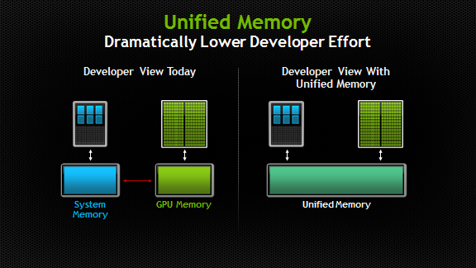
Before we get going…
Last time:
Advanced GPU memory issues
Zero-copy memory
Unified Virtual Addressing
Managed memory
Today:
Off-the-shelf GPU computing
thrust
CUB
Further discussion, Final Project topics
Other tidbits:
Assignment due on Thursday at 9 pm
This is the last “GPU computing” lecture
ME759 Exam: April 15, at 7:15 PM, in 1106ME
Review: Tu, April 14, at 7:00 PM, in Canvas
Old Memory Perception
New Perception with Unified Memory

Slide 4
GPU Computing with thrust

Slide 5
Three Ways to Accelerate on GPU
Application
Libraries
Directives
Programming Languages
Easiest Approach
Maximum Performance
Direction of increased performance
(and effort)
NVIDIA [C. Woolley]→
Notes:
On the NVIDIA website, Thrust is listed under “Libraries” (https://developer.nvidia.com/gpu-accelerated-libraries).

Slide 6
Acknowledgments
The thrust slides include material provided by Nathan Bell previously of NVIDIA (at Google now)
Modified here and there, responsible for inaccuracies

Slide 7
Design Philosophy, thrust
Increase programmer productivity
Build applications quickly via generic programming
Leverage a template-based approach
Should be running fast
Efficient leveraging of GPU hardware
NVIDIA [N. Bell]→

Slide 8
What is thrust?
A template library for parallel computing on GPU and CPU*
Mimics the C++ STL
Heavy use of C++ containers
The one lecture where C++ comes into play heavily
Provides ready to use generic algorithms
Sorting, reduction, scan, etc.
NVIDIA [N. Bell]→

Slide 9
What is thrust?
thrust is a header library
All its functionality accessed by #include-ing the appropriate thrust header file
Program is compiled with nvcc as per usual, no special tools are required
C++ syntax. Related to high-level, host-side code that you have to produce
The concepts of execution configuration, shared memory, occupancy, blah, blah, blah: all but gone
NVIDIA [N. Bell]→

Slide 10
Work Plan, thrust
Namespaces, containers, iterators
Algorithms
General transformations. Zipping & fusing
Thrust example: Processing rainfall data

Slide 11
Namespaces
Avoid name collisions: thrust vs. std namespaces
// allocate host memory
thrust::host_vector<int> h_vec(10);
// call STL sort
std::sort(h_vec.begin(), h_vec.end());
// call Thrust sort
thrust::sort(h_vec.begin(), h_vec.end());
// for brevity
using namespace thrust;
// without namespace
int sum = reduce(h_vec.begin(), h_vec.end());
NVIDIA [N. Bell]→
Notes:
You’ll notice that we use things like thrust::host_vector or thrust::copy in our examples. The thrust:: part tells the C++ compiler that we want to look inside the thrust namespace for a specific function or class. Namespaces are a nice way to avoid name collisions. For instance,thrust::copy is different from std::copy provided in the STL. C++ namespaces allow us to distinguish between these two copy functions.

Slide 12
thrust containers: host_vector & device_vector
thrust provides two vector containers: host_vector and device_vector
host_vector is stored in host memory
device_vector lives in GPU device memory
thrust’s vector containers are just like std::vector in the C++ STL
Like std::vector, host_vector & device_vector are generic containers – they store whatever
[NVIDIA]$→$

Slide 13
thrust containers: host_vector & device_vector
Common operations become concise & readable through use of containers
// allocate host vector with two elements
thrust::host_vector<int> h_vec(2);
// copy host vector to device
thrust::device_vector<int> d_vec;
// manipulate device values from the host
d_vec[0] = 13;
d_vec[1] = 27;
std::cout << "sum: " << d_vec[0] + d_vec[1] << std::endl;
// copy host vector to device
thrust::device_vector<int> h_vec = d_vec;
// vector memory automatically released w/ free() or cudaFree()
Notes:
Thrust provides two vector containers, host_vector and device_vector.
the = operator can be used to copy a host_vector to a device_vector (or vice-versa). The = operator can also be used to copy host_vector to host_vector or device_vector to device_vector.
note that individual elements of a device_vector can be accessed using the standard bracket notation. However, because each of these accesses requires a call to cudaMemcpy, use sparingly. We’ll look at some more efficient techniques later.

Slide 14
thrust containers
Compatible with STL containers (thrust & std containers play well together)
Below, a std list plays well with a thrust device vector
// list container on host
std::list<int> h_list;
h_list.push_back(13);
h_list.push_back(27);
// copy list to device vector
thrust::device_vector<int> d_vec(h_list.size());
thrust::copy(h_list.begin(), h_list.end(), d_vec.begin());
// alternative method using vector constructor
thrust::device_vector<int> d_vec2(h_list.begin(), h_list.end());
NVIDIA [N. Bell]→
Notes:
Another reason to distinguish between iterators and pointers is that iterators can be used to traverse many kinds of data structures. For example, the STL provides a linked list container (std::list) that provides bidirectional (but not random access) iterators. Although Thrust does not provide device implementations of such containers, it is compatible with them.
This eases integration

Slide 15
Iterators: think of them as pointers
Sequences are defined by pairs of iterators
For vector containers, iterators act like pointers
They can be used like pointers (e.g. incremented)
Can be converted to raw pointers
// allocate device vector
thrust::device_vector<int> d_vec(4);
d_vec.begin(); // returns iterator at first element of d_vec
d_vec.end(); // returns iterator one past the last element of d_vec
d_vec.begin()
d_vec.end()
Notes:
In the case of vector containers, which are really just arrays, iterators can be thought of as pointers to array elements. Therefore, H.begin() is an iterator that points to the first element of the array stored inside the H vector. Similarly, H.end() points to the element one past the last element of the H vector.

Slide 16
Interoperability: iterators to pointers
Convert iterators to raw pointers
// allocate device vector
thrust::device_vector<int> d_vec(4);
// obtain raw pointer to device vector’s memory
int * ptr = thrust::raw_pointer_cast(&d_vec[0]);
// use ptr in a CUDA C kernel
my_kernel<<< (N+255) / 256, 256 >>>(N, ptr);
// use ptr in a CUDA API function
cudaMemcpy(ptr, ... );
NVIDIA [N. Bell]→
Notes:
To extract a raw pointer from a device_ptr the raw_pointer_cast should be applied

Slide 17
Interoperability: pointers to iterators
Wrap raw pointers with device_ptr
// raw pointer to device memory
int * raw_ptr;
cudaMalloc((void **) &raw_ptr, N * sizeof(int));
// wrap raw pointer with a device_ptr
thrust::device_ptr<int> dev_ptr(raw_ptr);
// use device_ptr in thrust algorithms
thrust::fill(dev_ptr, dev_ptr + N, (int) 0);
// access device memory through device_ptr
dev_ptr[0] = 1;
// free memory
cudaFree(raw_ptr);
NVIDIA [N. Bell]→
Notes:
Like the STL, Thrust permits using a “raw” pointer as an argument to a Thrust function and it will dispatch the host path of the algorithm.
If the pointer in question is in fact a pointer to device memory then you’ll need to wrap it with thrust::device_ptr before calling the function.

Slide 18
Namespaces, containers, iterators: closing remarks
Namespaces
Used to avoids collisions and increase functionality
Containers
Manage both host & device memory
Automatic allocation and deallocation
Simplify data transfers
Iterators in thrust
Behave like pointers
Can move back-and-forth between iterators and raw pointers

Slide 19
Work Plan, thrust
Namespaces, containers, iterators
Algorithms
General transformations. Zipping & fusing
Thrust example: Processing rainfall data

Slide 20
Algorithms
Element-wise operations
for_each, transform, gather, scatter …
Reductions
reduce, inner_product, reduce_by_key …
Prefix Sums [scans]
inclusive_scan, inclusive_scan_by_key …
Sorting
sort, stable_sort, sort_by_key …
NVIDIA [N. Bell]→
Notes:
Thrust provides a large number of common parallel algorithms. Many of these algorithms have direct analogs in the STL, and when an equivalent STL function exists, we choose the name (e.g. thrust::sort and std::sort).
All algorithms in Thrust have implementations for both host and device. Specifically, when a Thrust algorithm is invoked with a host iterator, then the host path is dispatched. Similarly, a device implementation is called when a device iterator is used to define a range.
With the exception of thrust::copy, which can copy data between host and device, all iterator arguments to a Thrust algorithm should live in the same place: either all on the host or all on the device. When this requirement is violated the compiler will produce an error message.

Slide 21
Thrust Example: Sort
#include <thrust/host_vector.h>
#include <thrust/device_vector.h>
#include <thrust/sort.h>
int main(void) {
// generate 16M random numbers on the host
thrust::host_vector<int> h_vec(1 << 24);
thrust::generate(h_vec.begin(), h_vec.end(), rand);
// transfer data to the device
thrust::device_vector<int> d_vec = h_vec;
// sort data on the device
thrust::sort(d_vec.begin(), d_vec.end());
// transfer data back to host
thrust::copy(d_vec.begin(), d_vec.end(), h_vec.begin());
return 0;
}
NVIDIA [N. Bell]→

Slide 22
Leveraging Parallel Primitives, benchmark test
Test: sort 32M keys on each platform
Performance measured in millions of keys per second [higher is better]
Conclusion: sort is highly optimized
data type | std::sort [per second] | tbb::parallel_sort [per second] | thrust::sort [per second]
char | 25.1 | 68.3 | 3532.2
short | 15.1 | 46.8 | 1741.6
int | 10.6 | 35.1 | 804.8
long | 10.3 | 34.5 | 291.4
float | 8.7 | 28.4 | 819.8
double | 8.5 | 28.2 | 358.9
Intel Core i7 950 @3.07 GHz
NVIDIA GeForce 480
NVIDIA [N. Bell]→
Notes:
Sorting 32M keys on each platform - performance measured in millions of keys per second
CPU – Intel Core i7 950 @ 3.07 GHz
GPU – NVIDIA GeForce GTX 480
Lesson – use sorting instead of ad hoc binning b/c thrust::sort() is highly optimized

Slide 23
Input-Sensitive Optimizations
NVIDIA [N. Bell]→
Notes:
Sorting 32M unsigned integers (uniformly distributed) with different numbers of occupied key bits
For example, Key Bits = 20 means all keys are in the range [0, 2^20)
Reason: dispatched internally as a RADIX sort

Slide 24
Example: Vector Addition
for (int i = 0; i < N; i++)
Z[i] = X[i] + Y[i];
Z
X
Y
NVIDIA [N. Bell]→
Notes:
Transformations are algorithms that apply an operation to each element in a set of (zero or more) input ranges and then stores the result in a destination range.
The Thrust implementations rely on functors, which are function objects used to pass state and function objects, to perform transformation.
Let’s see how they come into play on a simple vector addition example

Slide 25
Example, Vector Addition
#include <thrust/device_vector.h>
#include <thrust/transform.h>
#include <thrust/functional.h>
#include <iostream>
int main(void) {
thrust::device_vector<float> X(3);
thrust::device_vector<float> Y(3);
thrust::device_vector<float> Z(3);
X[0] = 10; X[1] = 20; X[2] = 30;
Y[0] = 15; Y[1] = 35; Y[2] = 10;
thrust::transform(X.begin(), X.end(),
Y.begin(),
Z.begin(),
thrust::plus<float>());
for (size_t i = 0; i < Z.size(); i++)
std::cout << "Z[" << i << "] = " << Z[i] << "\n";
return 0;
}
NVIDIA [N. Bell]→
Notes:
Here, plus is a binary function defined in thrust/functional.h

Slide 26
Maximum Value – after all, it’s just a reduce operation
#include <thrust/device_vector.h>
#include <thrust/reduce.h>
#include <thrust/functional.h>
#include <iostream>
int main(void) {
thrust::device_vector<float> X(3);
X[0] = 10.f; X[1] = 30.f; X[2] = 20.f;
float init = X[0];
float result = thrust::reduce(X.begin(), X.end(),
init,
thrust::maximum<float>());
std::cout << "maximum is " << result << "\n";
return 0;
}
NVIDIA [N. Bell]→
Notes:
Functors can also be used with other types of algorithms, reduce in this case.
Here, maximum is a binary function defined in thrust/functional.h

Slide 27
Algorithms
Standard operators
// allocate memory
device_vector<int> A(10);
device_vector<int> B(10);
device_vector<int> C(10);
// transform A + B -> C
transform(A.begin(), A.end(), B.begin(), C.begin(), plus<int>());
// transform A - B -> C
transform(A.begin(), A.end(), B.begin(), C.begin(), minus<int>());
// multiply reduction
int product = reduce(A.begin(), A.end(), 1, multiplies<int>());
NVIDIA [N. Bell]→
Notes:
In previous examples, we have seen the use of various built-in functors (plus, maximum, etc).
Functors in thrust/functional.h cover most of the built-in arithmetic and comparison operations.

Slide 28
Example: SAXPY (of sorts)
a
for (int i = 0; i < N; i++)
Z[i] = a * X[i] + Y[i];
Z
X
Y
NVIDIA [N. Bell]→
Notes:
As an example of a custom functor for a “non-standard” operation, consider SAXPY

Slide 29
SAXPY
struct saxpy
{
float m_a;
saxpy(float a) : m_a(a) {}
__host__ __device__
float operator()(float x, float y)
{
return m_a * x + y;
}
};
state
constructor
functor
call operator
void main(void){
thrust::device_vector<float> X(3), Y(3), Z(3);
X[0] = 10; X[1] = 20; X[2] = 30;
Y[0] = 15; Y[1] = 35; Y[2] = 10;
float aVal = 2.0f;
thrust::transform(X.begin(), X.end(),
Y.begin(),
Z.begin(),
saxpy(aVal));
for (size_t i = 0; i < Z.size(); i++)
std::cout << "Z[" << i << "] = " << Z[i] << "\n";
}
NVIDIA [N. Bell]→
Notes:
If we want to implement SAXPY with Thrust we have a few options:
The first is to use two transformations (one addition and one multiplication) and a temporary vector filled with the value a.
A better choice is to use a single transformation with a user-defined functor that does exactly what we want.

Slide 30
Custom Types & Operators
struct negate_float2
{
__host__ __device__
float2 operator()(float2 a)
{
return make_float2(-a.x, -a.y);
}
};
// declare storage
device_vector<float2> input = ...
device_vector<float2> output = ...
// create function object or ‘functor’
negate_float2 fnctr;
// negate vectors
transform(input.begin(), input.end(), output.begin(), fnctr);
NVIDIA [N. Bell]→
Notes:
When the built-in functors are not enough, you can define your own.
Here, note also that we are using a CUDA type (float2)

Slide 31
Custom Types & Operators
// compare x component of two float2 structures
struct compare_float2
{
__host__ __device__
bool operator()(float2 a, float2 b)
{
return a.x < b.x;
}
};
// declare storage
device_vector<float2> vec = ...
// create comparison functor
compare_float2 comp;
// sort elements by x component
sort(vec.begin(), vec.end(), comp);
NVIDIA [N. Bell]→
Notes:
Custom functor objects are useful if:
Performing a “non-standard” operation (see SAXPY example later)
Working on “non-standard” data (e.g. float2)
This example uses a custom functor to define one possible definition of “less than” for a float2.

Slide 32
Custom Types & Operators
// return true if x is greater than threshold
struct is_greater_than
{
int threshold;
is_greater_than(int t) { threshold = t; }
__host__ __device__
bool operator()(int x) { return x > threshold; }
};
device_vector<int> vec = ...
// create predicate functor (returns true for x > 10)
is_greater_than pred(10);
// count number of values > 10
int result = count_if(vec.begin(), vec.end(), pred);
NVIDIA [N. Bell]→
Notes:
As mentioned before, functors can have state.
Note that this could be implemented more concisely as:
int result = thrust::count_if(vec.begin(), vec.end(), _1 > 10);

Slide 33
Algorithms, More Examples…
Algorithm | Description
reduce | Sum of a sequence
find | First position of a value in a sequence
mismatch | First position where two sequences differ
inner_product | Dot product of two sequences
equal | Whether two sequences are equal
min_element | Position of the smallest value
count | Number of instances of a value
is_sorted | Whether sequence is in sorted order
transform_reduce | Sum of transformed sequence
NVIDIA [N. Bell]→
Notes:
Searching, Copying, Reductions, Reorderings, Scans, Sorting, Transformations, Set Operations,…

Slide 34
Work Plan, thrust
Namespaces, containers, iterators
Algorithms
General transformations. Zipping & fusing
Thrust example: Processing rainfall data

Slide 35
General Transformations
for (int i = 0; i < N; i++)
X[i] = f(A[i]);
Unary Transformation
for (int i = 0; i < N; i++)
X[i] = f(A[i],B[i]);
Binary Transformation
for (int i = 0; i < N; i++)
X[i] = f(A[i],B[i],C[i]);
Ternary Transformation
for (int i = 0; i < N; i++)
X[i] = f(A[i],B[i],C[i],...);
General Transformation
Like C++ STL, thrust provides built-in support for unary and binary transformations
Transformations involving 3 or more input ranges must use a different approach
NVIDIA [N. Bell]→

Slide 36
The Zip Operation (“zipping”)
A0
A1
A2
…
A0
A1
A2
zip_iterator
…
X0
X1
X2
…
X0
X1
X2
Multiple
Distinct
Sequences
Unique
Sequence
of Tuples
NVIDIA [N. Bell]→

Slide 37
Example: General Transformations
#include <thrust/device_vector.h>
#include <thrust/transform.h>
#include <thrust/iterator/zip_iterator.h>
#include<iostream>
struct linear_combo {
__host__ __device__
float operator()(thrust::tuple<float,float,float> t) {
float x, y, z;
thrust::tie(x,y,z) = t;
return 2.0f * x + 3.0f * y + 4.0f * z;
}
};
Functor
Definition
void main(void) {
thrust::device_vector<float> X(3), Y(3), Z(3);
thrust::device_vector<float> U(3); // U = 2X + 3Y + 4Z
X[0] = 10; X[1] = 20; X[2] = 30;
Y[0] = 15; Y[1] = 35; Y[2] = 10;
Z[0] = 20; Z[1] = 30; Z[2] = 25;
thrust::transform
(thrust::make_zip_iterator(thrust::make_tuple(X.begin(), Y.begin(), Z.begin())),
thrust::make_zip_iterator(thrust::make_tuple(X.end(), Y.end(), Z.end())),
U.begin(),
linear_combo());
for (size_t i = 0; i < Z.size(); i++)
std::cout << "U[" << i << "] = " << U[i] << "\n";
}
These are the important parts: three different entities are zipped together into a big one
NVIDIA [N. Bell]→

Slide 38
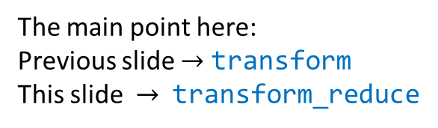
Example: thrust::transform_reduce
#include <thrust/transform_reduce.h>
#include <thrust/device_vector.h>
#include <thrust/iterator/zip_iterator.h>
#include<iostream>
struct linear_combo {
__host__ __device__
float operator()(thrust::tuple<float,float,float> t) {
float x, y, z;
thrust::tie(x,y,z) = t;
return 2.0f * x + 3.0f * y + 4.0f * z;
}
};
void main(void) {
thrust::device_vector<float> X(3), Y(3), Z(3), U(3);
X[0] = 10; X[1] = 20; X[2] = 30;
Y[0] = 15; Y[1] = 35; Y[2] = 10;
Z[0] = 20; Z[1] = 30; Z[2] = 25;
thrust::plus<float> binary_op;
float init = 0.f;
float myResult = thrust::transform_reduce
(thrust::make_zip_iterator(thrust::make_tuple(X.begin(), Y.begin(), Z.begin())),
thrust::make_zip_iterator(thrust::make_tuple(X.end(), Y.end(), Z.end())),
linear_combo(),
init,
binary_op);
std::cout << myResult << std::endl;
}
The main point here:
Previous slide $→$ transform
This slide $→$ transform_reduce
Punch line: “fusing” operations together whenever possible is a good idea
Notes:
Note: a tuple can have a max. number of 10 elements. Can use hierarchical tuples. Also, work on variadic template support (not sure if merged in main trunk).

Slide 39
Performance Considerations [discussion tided to “fusing”]
Picture below shows the two key parameters in any computation
Peak flop rate
Max bandwidth
Tesla C2050 data
144 GB/s
1030 GFLOP/s
[Single Precision]
SMs
DRAM
Punch line (for Tesla C2050):
In one second I do 1030 GFLOPs. In one second, I can bring over 144 GB of data
Therefore, on average, I need to do 1030/144 operations per byte of data; i.e., an average of 7.1 ops per byte
NVIDIA [N. Bell]→
Notes:
Zip operators: take care of reorganizing data for thrust use.
We will talk next about fusing operations: take care of reorganizing computations for thrust use.
Your problem at hand can hit one of two bounds: the FLOP bound or the BANDWIDTH bound (compute-bound, memory-bound)

Slide 40
Arithmetic Intensity [discussion tided to “fusing”]
Kernel | FLOP/Byte*
Vector Addition | 1 : 12
SAXPY | 2 : 12
Max Index | 1 : 12
Reduce | 1 : 4
Ternary Transformation | 5 : 16
Hardware** | FLOP/Byte
GeForce GTX 280 | ~7.0 : 1
GeForce GTX 480 | ~7.6 : 1
Tesla C870 | ~6.7 : 1
Tesla C1060 | ~9.1 : 1
Tesla C2050 | ~7.1 : 1
* excludes indexing overhead
** lists the number of flop per byte of data to reach peak Flop/s rate
“Byte” refers to a Global Memory byte
Ternary Transformation: $w[i] =α x[i] +β y[i] +γ z[i]$
NVIDIA [N. Bell]→
Notes:
Max index: compare two, and possibly store an index – therefore, you handle three entities.
More precisely: you bring an index, the associated value. If the new index “wins”, then you store it in memory.
Compare how far the arithmetic intensities are from the values that would leverage the hardware. On a GTX480 you should be able to perform 8 operations for each byte you bring over.
Ternary: w[i] = \alpha x[i] + \beta y[i] + \gamma z[i]

Slide 41
Arithmetic Intensity [discussion tided to “fusing”]
Memory bound
Compute bound
FLOP/Byte
SAXPY
FFT
SGEMM
NVIDIA [N. Bell]→

Slide 42
Fusing, as a strategy to increase the arithmetic intensity
for (int i = 0; i < N; i++)
U[i] = F(X[i],Y[i],Z[i]);
for (int i = 0; i < N; i++)
{
U[i] = F(X[i],Y[i],Z[i]);
V[i] = G(X[i],Y[i],Z[i]);
}
for (int i = 0; i < N; i++)
V[i] = G(X[i],Y[i],Z[i]);
Loop Fusion
One way to look at things…
Zipping: reorganizes data for thrust processing
Fusing: reorganizes computation for efficient thrust processing
NVIDIA [N. Bell]→
Notes:
So what can we do to maximize the work we do for the same amount of data transferred?
Simple idea… But powerful

Slide 43
Fusing Transformations
typedef thrust::tuple<float,float> Tuple2;
typedef thrust::tuple<float,float,float> Tuple3;
struct linear_combo {
__host__ __device__
Tuple2 operator()(Tuple3 t) {
float x, y, z; thrust::tie(x,y,z) = t;
float u = 2.0f * x + 3.0f * y + 4.0f * z;
float v = 1.0f * x + 2.0f * y + 3.0f * z;
return Tuple2(u,v);
}
};
void main(void) {
thrust::device_vector<float> X(3), Y(3), Z(3);
thrust::device_vector<float> U(3), V(3);
X[0] = 10; X[1] = 20; X[2] = 30;
Y[0] = 15; Y[1] = 35; Y[2] = 10;
Z[0] = 20; Z[1] = 30; Z[2] = 25;
thrust::transform
(thrust::make_zip_iterator(thrust::make_tuple(X.begin(), Y.begin(), Z.begin())),
thrust::make_zip_iterator(thrust::make_tuple(X.end(), Y.end(), Z.end())),
thrust::make_zip_iterator(thrust::make_tuple(U.begin(), V.begin())),
linear_combo());
}
Functor
Definition
NVIDIA [N. Bell]→
Notes:
Zip iterator: bring data together
Fusing operations: bring operations together

Slide 44
Fusing Transformations in Previous Example
Original Implementation
Optimized Implementation
12 Bytes
4 Bytes
12 Bytes
12 Bytes
8 Bytes
GPU
4 Bytes
DRAM
GPU
DRAM
Since the operation is completely memory bound the expected speedup is ~1.6x (=32/20)
NVIDIA [N. Bell]→
Notes:
What does this fusing get us?
Since the operation is completely memory bound the expected speedup is ~1.6x (=32/20)

Slide 45
Fusing Transformations
for (int i = 0; i < N; i++)
Y[i] = F(X[i]);
for (int i = 0; i < N; i++)
sum += F(X[i]);
for (int i = 0; i < N; i++)
sum += Y[i];
Loop Fusion
NVIDIA [N. Bell]→
Notes:
Another example of loop fusion

Slide 46
Fusing Transformations
#include <thrust/device_vector.h>
#include <thrust/transform_reduce.h>
#include <thrust/functional.h>
#include <iostream>
using namespace thrust::placeholders;
int main(void) {
thrust::device_vector<float> X(3);
X[0] = 10; X[1] = 30; X[2] = 20;
float result = thrust::transform_reduce
(X.begin(), X.end(),
_1 * _1,
0.0f,
thrust::plus<float>());
std::cout << "sum of squares is " << result << "\n";
return 0;
}
NVIDIA [N. Bell]→
Notes:
Calculate sum of squares.
Note a different way of specifying the binary operation

Slide 47
Fusing Transformations in Previous Example
Original Implementation
Optimized Implementation
4 Bytes
4 Bytes
4 Bytes
4 Bytes
GPU
DRAM
GPU
DRAM
Try to answer this: how many times will we be able to run faster if we fuse?
NVIDIA [N. Bell]→
Notes:
Since the operation is completely memory bound the expected speedup is ~3x (=12/4)
The numbers of bytes are showing what happens for each i, from i=1 to 3 (or lengths of array)

Slide 48
thrust Wrap-Up
Good productivity and execution boost at the price of having to deal with C++ syntax
No need to be aware of execution configuration, shared memory, etc.
Key concepts
Functor
Zipping data
Fusing operations
Why not always use thrust?
There is no “perform finite element analysis” support in thrust
Thrust provides support for primitives – up to us to use them as needed

Slide 49
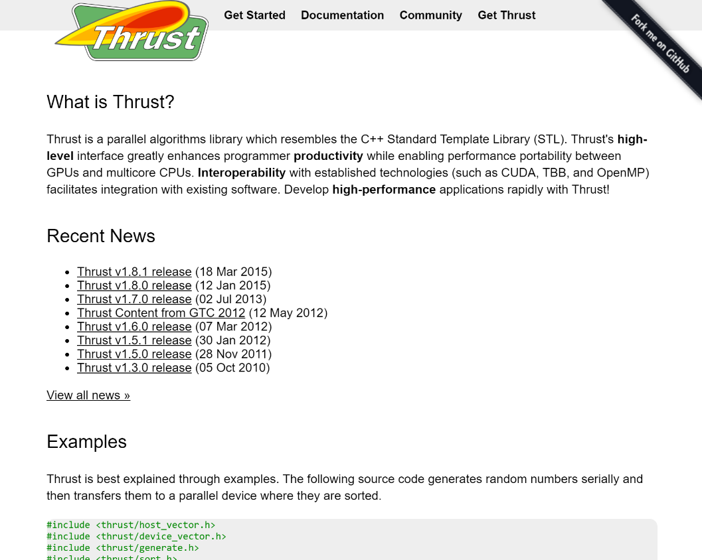
thrust on GitHub
Quick Start Guide
Examples
News
Documentation
Mailing List (thrust-users)
http://thrust.github.io/
NVIDIA [N. Bell]→

Slide 50
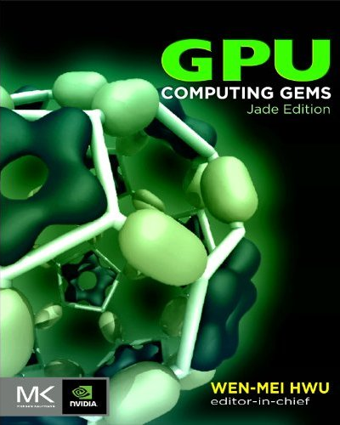
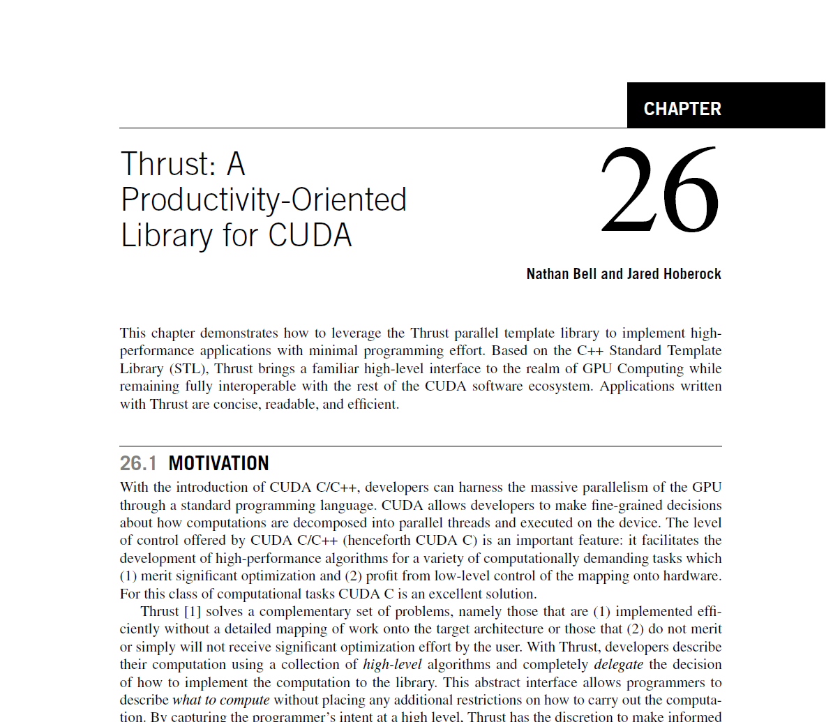
thrust in “GPU Computing Gems”
PDF available at http://goo.gl/adj9S
NVIDIA [N. Bell]→

Slide 51
Work Plan, thrust
Namespaces, containers, iterators
Algorithms
General transformations. Zipping & fusing
Thrust example: Processing rainfall data

Slide 52
Example, thrust: Processing Rainfall Data
1
0
3
3
Rain situation, end of first day, for a set of five observation stations. Results, summarized over a period of time, reported in the table below.
2
2
4
day [0 0 1 2 5 5 6 6 7 8 ... ]
site [2 3 0 1 1 2 0 1 2 1 ... ]
measurement [9 5 6 3 3 8 2 6 5 9 ... ]
Remarks:
Time series sorted by day
Measurements of zero are excluded from the time series
NVIDIA [N. Bell]→

Slide 53
Example: Processing Rainfall Data
day [0 0 1 2 5 5 6 6 7 8 ... ]
site [2 3 0 1 1 2 0 1 2 1 ... ]
measurement [9 5 6 3 3 8 2 6 5 9 ... ]
Given the data above, here’re some questions you might ask:
Total rainfall at a given site
Total rainfall between given days
Total rainfall on each day
Number of days with any rainfall
NVIDIA [N. Bell]→

Slide 54
Total Rainfall at a Given Site
struct one_site_measurement
{
int siteOfInterest;
one_site_measurement(int site) : siteOfInterest(site) {}
__host__ __device__
int operator()(thrust::tuple<int,int> t)
{
if (thrust::get<0>(t) == siteOfInterest)
return thrust::get<1>(t);
else
return 0;
}
};
template <typename Vector>
int compute_total_rainfall_at_one_site(int siteID, const Vector& site, const Vector& measurement)
{
return thrust::transform_reduce
(thrust::make_zip_iterator(thrust::make_tuple(site.begin(), measurement.begin())),
thrust::make_zip_iterator(thrust::make_tuple(site.end(), measurement.end())),
one_site_measurement(siteID),
0,
thrust::plus<int>());
}
Functor
Definition
NVIDIA [N. Bell]→
Notes:
transform_reduce fuses the transform and reduce operations. transform_reduce is equivalent to performing a transformation defined by unary_op into a temporary sequence and then performing reduce on the transformed sequence. In most cases, fusing these two operations together is more efficient, since fewer memory reads and writes are required.
transform_reduce performs a reduction on the transformation of the sequence [first, last) according to unary_op. Specifically, unary_op is applied to each element of the sequence and then the result is reduced to a single value with binary_op using the initial value init. Note that the transformation unary_op is not applied to the initial value init. The order of reduction is not specified, so binary_op must be both commutative and associative.

Slide 55
Total Rainfall Between Given Days
template <typename Vector>
int compute_total_rainfall_between_days(int first_day, int last_day,
const Vector& day, const Vector& measurement)
{
int first = thrust::lower_bound(day.begin(), day.end(), first_day) - day.begin();
int last = thrust::upper_bound(day.begin(), day.end(), last_day) - day.begin();
return thrust::reduce(measurement.begin() + first, measurement.begin() + last);
}
lower_bound( ... , 2)
upper_bound( ... , 6)
day [0 0 1 2 5 5 6 6 7 8 ... ]
measurement [9 5 6 3 3 8 2 6 5 9 ... ]
#include <thrust/device_vector.h>
#include <thrust/binary_search.h>
#include <thrust/transform.h>
#include <thrust/iterator/zip_iterator.h>
#include <iostream>
You will need to include several header files (not all for the code snippet above)
NVIDIA [N. Bell]→
Notes:
reduce is a generalization of summation: it computes the sum (or some other binary operation) of all the elements in the range [first, last). This version of reduce uses 0 as the initial value of the reduction. reduce is similar to the C++ Standard Template Library's std::accumulate. The primary difference between the two functions is that std::accumulate guarantees the order of summation, while reduce requires associativity of the binary operation to parallelize the reduction.
Note that reduce also assumes that the binary reduction operator (in this case operator+) is commutative. If the reduction operator is not commutative then thrust::reduce should not be used. Instead, one could use inclusive_scan (which does not require commutativity) and select the last element of the output array.

Slide 56


Number of Days with Any Rainfall
template <typename Vector>
int compute_number_of_days_with_rainfall(const Vector& day)
{
return thrust::inner_product(day.begin(), day.end() - 1,
day.begin() + 1,
0,
thrust::plus<int>(),
thrust::not_equal_to<int>()) + 1;
}
$$⊕$$
$$⊗$$
day [0 0 1 2 5 5 6 6 7 8 ... ]
1 [0 1 1 1 0 1 0 1 1 ... ]
$$\text{inner}\text{_}\text{product}\left(x,y\right)=\left(x_{0}⊗y_{0}\right)⊕\left(x_{1}⊗y_{1}\right)⊕ \left(x_{2}⊗y_{2}\right)⊕…$$
NVIDIA [N. Bell]→
Notes:
inner_product calculates an inner product of the ranges [first1, last1) and [first2, first2 + (last1 - first1)).
This version of inner_product is identical to the first, except that is uses two user-supplied function objects instead of operator+ and operator*.
Specifically, this version of inner_product computes the sum binary_op1( init, binary_op2(*first1, *first2) ), ...
Unlike the C++ Standard Template Library function std::inner_product, this version offers no guarantee on order of execution.

Slide 57
Total Rainfall on Each Day
template <typename Vector>
void compute_total_rainfall_per_day(const Vector& day, const Vector& measurement,
Vector& day_output, Vector& measurement_output)
{
size_t N = compute_number_of_days_with_rainfall(day); //see previous slide
day_output.resize(N);
measurement_output.resize(N);
thrust::reduce_by_key(day.begin(), day.end(),
measurement.begin(),
day_output.begin(),
measurement_output.begin());
}
day [0 0 1 2 5 5 6 6 7 8 ... ]
measurement [9 5 6 3 3 8 2 6 5 9 ... ]
day_output [0 1 2 5 6 7 8 ... ]
measurement_output [14 6 3 11 8 5 10 ... ]
NVIDIA [N. Bell]→
Notes:
reduce_by_key is a generalization of reduce to key-value pairs. For each group of consecutive keys in the range [keys_first, keys_last) that are equal, reduce_by_keycopies the first element of the group to the keys_output. The corresponding values in the range are reduced using the plus and the result copied to values_output.
This version of reduce_by_key uses the function object equal_to to test for equality and plus to reduce values with equal keys.

Slide 58
GPU Computing with CUB

Slide 59
Hi, my name is CUB!
People know me as CUB, but my real name is “CUDA UnBound”
Currently, I’m at version V1.8.0 (DOB: 02/16/2018)
I’m developed as open-source project by good folks at NVIDIA Research
Primary contributor: Duane Merrill
You can fork me if you want (on GitHub: https://github.com/NVlabs/cub)
Something about me: I can run really, really fast…

Slide 60
CUB, factoids
CUB provides software components at each layer of the CUDA programming model
Like thrust, it’s a headers library, not one binary file that you link against
Implications, given that it’s a header-file library:
When you need to call a function, you need to include the header file that includes the *source* code of the CUB function you want to call
Rationale, header-file library: if the compiler sees the code, it can engage in all sort of optimizations
Inlining, heavy use of templating, compiles for the exact architecture you have, etc.
Fallout: it takes forever to compile
[NVIDIA]$→$

Slide 61
Straight from CUB webpage
Device-wide primitives
Sort, prefix scan, reduction, histogram, etc.
Compatible with CUDA dynamic parallelism
Block-wide “collective” primitives
I/O, sort, prefix scan, reduction, histogram, etc.
Compatible with arbitrary thread block sizes and types
Warp-wide “collective” primitives
Warp-wide prefix scan, reduction, etc.
Safe and architecture-specific
Thread and resource utilities
PTX intrinsics, device reflection, texture-caching iterators, caching memory allocators, etc.
[NVIDIA]$→$

Slide 62
CUB ruminations
The device-wide support is not a novelty, thrust does it too…
thrust built on top of CUB, by the way
The novelty:
You can call CUB from a kernel function that uses the threads in one block to accomplish something
You can call CUB from a kernel function that uses the threads in a warp to accomplish something
The threads in a warp start behaving like the 32 threads of a chip with 32 cores running 32 threads
What can the threads in a block or a warp do:
Do a reduce, prefix scan, sort, etc. on a chunk of memory

Slide 63
Reiterating what CUB does [slide hyperlinks should work…]
Parallel primitives
Warp-wide "collective" primitives
Cooperative warp-wide prefix scan, reduction, etc.
Safely specialized for each underlying CUDA architecture
Block-wide "collective" primitives
Cooperative I/O, sort, scan, reduction, histogram, etc.
Compatible with arbitrary thread block sizes and types
Device-wide primitives
Parallel sort, prefix scan, reduction, histogram, etc.
Compatible with CUDA dynamic parallelism
Utilities
Fancy iterators
Thread and thread block I/O
PTX intrinsics
Device, kernel, and storage management
[NVIDIA]$→$

Slide 64

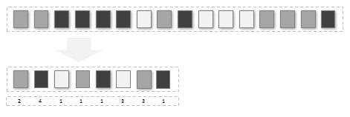

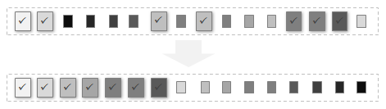
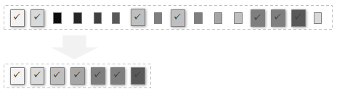

CUB, device-wide operations
You can call these from you C host code:
Histogram
Partition
Radix sort
Reduce
Run length encode
Scan
Select
Sparse matrix-vector multiplications
[NVIDIA]$→$

Slide 65




CUB, block-wide operations [callable from a kernel function]
BlockDiscontinuity class provides collective methods for flagging discontinuities within an ordered set of items partitioned across a CUDA thread block
BlockExchange class provides collective methods for rearranging data partitioned across a CUDA thread block
BlockHistogram
BlockLoad class provides collective data movement methods for loading a linear segment of items from memory into a blocked arrangement across a CUDA thread block
BlockRadixSort class provides collective methods for sorting items partitioned across a CUDA thread block using a radix sorting method
BlockReduce
BlockScan
BlockStore class provides collective data movement methods for writing a blocked arrangement of items partitioned across a CUDA thread block to a linear segment of memory
[NVIDIA]$→$

Slide 66
CUB, warp-level primitives
Idea: each warp of threads will work on a chunk of an array and do a scan or reduce on that chunk of the array
WarpScan class provides collective methods for computing a parallel prefix scan of items partitioned across a CUDA thread warp.
WarpReduce class provides collective methods for computing a parallel reduction of items partitioned across a CUDA thread warp.
[NVIDIA]$→$

Slide 67
Example, CUB: sort by key, device-level operation
// device side setup
unsigned int* d_keysIN = NULL;
unsigned int* d_keysOUT = NULL;
pairsOfBodies* d_valsIN = NULL;
pairsOfBodies* d_valsOUT = NULL;
CubDebugExit(g_allocator.DeviceAllocate((void**)& d_keysIN, sizeof(unsigned int) * num_items));
CubDebugExit(g_allocator.DeviceAllocate((void**)& d_keysOUT, sizeof(unsigned int) * num_items));
CubDebugExit(g_allocator.DeviceAllocate((void**)& d_valsIN, sizeof(pairsOfBodies) * num_items));
CubDebugExit(g_allocator.DeviceAllocate((void**)& d_valsOUT, sizeof(pairsOfBodies) * num_items));
// get memory set aside on the device
size_t temp_storage_bytes = 0;
void* d_temp_storage = NULL;
CubDebugExit(DeviceRadixSort::SortPairs(d_temp_storage, temp_storage_bytes, d_keysIN, d_keysOUT, d_valsIN, d_valsOUT, num_items)); // Caching allocator for device memory
CubDebugExit(g_allocator.DeviceAllocate(&d_temp_storage, temp_storage_bytes));
// initialize data on the device
CubDebugExit(cudaMemcpy(d_keysIN, h_keys, sizeof(unsigned int) * num_items, cudaMemcpyHostToDevice));
CubDebugExit(cudaMemcpy(d_valsIN, h_vals, sizeof(pairsOfBodies) * num_items, cudaMemcpyHostToDevice));
// do the actual sort
CubDebugExit(DeviceRadixSort::SortPairs(d_temp_storage, temp_storage_bytes, d_keysIN, d_keysOUT, d_valsIN, d_valsOUT, num_items));
// get data back
CubDebugExit(cudaMemcpy(h_keys_out, d_keysOUT, sizeof(unsigned int) * num_items, cudaMemcpyDeviceToHost));
CubDebugExit(cudaMemcpy(h_vals_out, d_valsOUT, sizeof(pairsOfBodies) * num_items, cudaMemcpyDeviceToHost));
// clean up
if (d_keysIN) CubDebugExit(g_allocator.DeviceFree(d_keysIN));
if (d_keysOUT) CubDebugExit(g_allocator.DeviceFree(d_keysOUT));
if (d_valsIN) CubDebugExit(g_allocator.DeviceFree(d_valsIN));
if (d_valsOUT) CubDebugExit(g_allocator.DeviceFree(d_valsOUT));
if (d_temp_storage) CubDebugExit(g_allocator.DeviceFree(d_temp_storage));
return 0;
}
#define CUB_STDERR // print CUDA runtime errors to console
#include <cub/util_allocator.cuh>
#include <cub/device/device_radix_sort.cuh>
#include "test/test_util.h"
using namespace cub;
// Caching allocator for device memory
CachingDeviceAllocator g_allocator(true);
struct pairsOfBodies {
unsigned int body_I;
unsigned int body_J;
};
int main() {
const unsigned int num_items = 8;
// host side setup
pairsOfBodies h_vals[num_items];
unsigned int h_keys[num_items] = { 2 , 0, 7, 3, 5, 4, 1, 6 };
pairsOfBodies h_vals_out[num_items];
unsigned int h_keys_out[num_items];
h_vals[0].body_I = 3; h_vals[0].body_J = 0;
h_vals[1].body_I = 9; h_vals[1].body_J = 2;
h_vals[2].body_I = 0; h_vals[2].body_J = 9;
h_vals[3].body_I = 2; h_vals[3].body_J = 4;
h_vals[4].body_I = 1; h_vals[4].body_J = 5;
h_vals[5].body_I = 1; h_vals[5].body_J = 7;
h_vals[6].body_I = 2; h_vals[6].body_J = 9;
h_vals[7].body_I = 6; h_vals[7].body_J = 8;

Slide 68
Example, CUB: reduce, device-level operation
#define CUB_STDERR // print CUDA runtime errors to console
#include <stdio.h>
#include <cub/util_allocator.cuh>
#include <cub/device/device_reduce.cuh>
#include "test/test_util.h"
using namespace cub;
CachingDeviceAllocator g_allocator(true); // Caching allocator for device memory
int main() {
const size_t num_items = 10;
// Set up host arrays
int h_in[num_items] = { 2, 3, -1, 0, 3, 6, 7, 2, -2, 0 };
int sum = 0;
for (unsigned int i = 0; i < num_items; i++)
sum += h_in[i];
// Set up device arrays
int* d_in = NULL;
CubDebugExit(g_allocator.DeviceAllocate((void**)& d_in, sizeof(int) * num_items));
// Initialize device input
CubDebugExit(cudaMemcpy(d_in, h_in, sizeof(int) * num_items, cudaMemcpyHostToDevice));
// Setup device output array
int* d_sum = NULL;
CubDebugExit(g_allocator.DeviceAllocate((void**)& d_sum, sizeof(int) * 1));
// Request and allocate temporary storage
void* d_temp_storage = NULL;
size_t temp_storage_bytes = 0;
CubDebugExit(DeviceReduce::Sum(d_temp_storage, temp_storage_bytes, d_in, d_sum, num_items));
CubDebugExit(g_allocator.DeviceAllocate(&d_temp_storage, temp_storage_bytes));
// Do the actual reduce operation
CubDebugExit(DeviceReduce::Sum(d_temp_storage, temp_storage_bytes, d_in, d_sum, num_items));
int gpu_sum;
CubDebugExit(cudaMemcpy(&gpu_sum, d_sum, sizeof(int) * 1, cudaMemcpyDeviceToHost));
// Check for correctness
printf("\t%s\n", (gpu_sum == sum ? "Test passed." : "Test falied."));
printf("\tSum is: %d\n", gpu_sum);
// Cleanup
if (d_in) CubDebugExit(g_allocator.DeviceFree(d_in));
if (d_sum) CubDebugExit(g_allocator.DeviceFree(d_sum));
if (d_temp_storage) CubDebugExit(g_allocator.DeviceFree(d_temp_storage));
return 0;
}

Slide 69
CUB, departing thoughts
CUB is not the friendliest library to use, and the documentation is dense and limited
CUB provides amazing performance
Use it when you start processing big data
It’s worth spending the time to make friends with CUB
We use CUB in the lab

Slide 70
Final Project Issues

Slide 71
Default Final Project topic suggested by Dan
Work on a parallel code used in Europe and Japan to deploy rover on moon of Mars
As is, the code is too slow
Tasks:
Profiling the code
Suggest speed improvements
Implement some of your suggestions for speed improvements

Slide 72
Intel-suggested Final Project topics
Coming from group at Intel made up of 13 compiler engineers working on optimizing machine learning workloads on various hardware platforms
Work w/ specialized hardware groups to ensure fast execution of inference and training workloads through hardware-software codesign
See https://github.com/plaidml/plaidml
Currently working closely with the LLVM community and the MLIR group at google to contribute to the affine dialect in MLIR
See https://mlir.llvm.org/docs/Dialects/AffineOps
Researching repurposing machine learning optimization techniques for scientific workloads

Slide 73
Default Final Project topics suggested by Intel group
Topic | Description | Helpful References
LLVM Optimization Analysis | Analyze LLVM Optimization Passes using established benchmarks | https://rd.springer.com/content/pdf/10.1007%2F978-3-319-91479-4_23.pdf
Survey and Analysis of Tensor Compilers | Analyze and benchmark tensor compilers for ML across various HW OR Investigate the results produced in 2. | https://arxiv.org/abs/2002.03794 http://www.eecs.harvard.edu/~htk/publication/2019-mapl-tillet-kung-cox.pdf
High performance GEMM library for a GPU | Utilizing the techniques described in papers 1 and 2 on the right And the MLIR's new support for affine.parallel: (see 3 on the right) Implement a high performance GEMM library for a GPU | https://arxiv.org/abs/2003.00532 https://paperswithcode.com/paper/stripe-tensor-compilation-via-the-nested https://mlir.llvm.org/docs/Dialects/AffineOps/#affineparallel-affineparallelop
Distributed SLIDE | Reproduce the results presented for SLIDE in 1. Using the code provided on github (2) Implement a distributed version of SLIDE. | https://arxiv.org/pdf/1903.03129.pdf https://github.com/keroro824/HashingDeepLearning/tree/master/SLIDE

Slide 74
Intel related Final Projects
The Intel folks will read your Final Project
Participate only if you are OK with this. Maybe you don’t want to share your findings/work
You’ll have to explicitly indicate that you are ok with me sharing your Final Project with them
There will be an option in the Final Project template
Note: there will be two templates
Final Project Proposal
Final Project Report

